Slide 1

Text Analytics Architecture

Slide 2











User will browse the required CSV file from their system
Lamda1 will get triggered
Fetch csv data and parameter, transfer file to backup, divide the data into chunks and send over sqs queue
Trigger Lambda2 and passes the data
Region : us-east-1
Public n/w
SQS Queue
CONF.ini
User system
input
Do operation on chunks, save in process till last chunk
Lambda1
Input Bucket
User will receive the download link
input-backup
Cloudwatch
Consolidation happens at last and file goes to output folder
process
Lambda2
output
Output Bucket

Slide 3
LIVE DEMO http://uspsinput.s3-website-us-east-1.amazonaws.com

Slide 4
Financials
Initial Account Set up Cost
Sign up with https://openai.com/ for a paid account for Voxai using company credit card.
We will license ChatGPT Turbo 3.5.
Account type is “Pay as you go”. A temporary authorization hold will be placed on the card for $5. At the end of each calendar month, Voxai will be charged for all usage during the month.
Usage charges are explained below in “Running Costs”.
Running Costs
Assumed we will run the analysis on 20,000 transcriptions daily for all 365 days a year classifying all 8 parameters.
This (20K per day) is realistic based on our current usage pattern at USPS.
Cost will be on pay-per-use mode and scales up or down depending on the volume of the transcriptions we want analysis done.
Two components to Running costs:
AWS Costs
The proposed “serverless” architecture for the assumed usage of USPS, costs us roughly $250 per year.
ChatGPT costs
ChatGPT bills on prompt tokens (number of characters used in prompt) and completion tokens (number of characters used for output).
The proposed pay-per-use model of ChatGPT Turbo 3.5 for the assumed usage of USPS, costs us roughly $2,000 per year.
We put together a calculator to forecast the cost for any customer based on transcription volume.

Slide 5
What now? / What Next
What Now?
Did all the evaluations with a trial license which has a huge Rate limitation.
For analyzing a single transcription for 8 parameters we need three iterations with 1 minute pause after each iteration.
So for 1 transcription, it takes 3 minutes and a few seconds. To run analysis on a mere 100 transcriptions, we need 5 hours because of throttling.
With this huge limitation and paying for the license from personal funds we managed so far.
Now we need to get a real license to complete the testing to conclude this project.
Also for Poornima’s team to use and test with this we can’t have these rate limitations.
What we are asking – an actual license backed by a Company Credit card with an initial $5 charge and a pay-per-use which won’t be much – may be more like a max of $30-$50 per month for all our testing for 3-4 months.
What Next?
Complete thorough testing for large samples, race conditions, edge conditions, multiple files
Have Poornima’s team conclude testing
Also do more testing with various data sets from other verticals like – Health Care, Financials, and other common ones to ensure we have a trained and ready-to-deploy model in place.
Test purge policies etc.
Continue further R&D as needed.

Slide 6
Some salient points on Architecture
“Fully scalable” “Highly Available” “Cloud Solution” built on “Serverless” Architecture.
Accessible over the internet from any browser to upload files that need analysis and URL where the output can be downloaded.
Uses AWS components – S3 buckets, Lambda functions, SQS, and CloudWatch:
S3 Buckets for collecting input until processed, and storing output until downloaded. A purge policy is defined for automatic maintenance.
Lambda functions – using 2 lambda functions to ensure parallel processing and guarantee completion of the entire analysis quickly:
Lambda-1: The addition of an input file into the S3 bucket triggers a Lambda-1. A separate “Lambda–1” instance for each input file ensures parallel processing of all files submitted for analysis.
Process the input file – split into smaller chunks if needed.
Each chunk contains just as many transcriptions that can be fully analyzed within 15 mins (max time for Lambda).
Add each chunk to the SQS Queue.
Lambda-2: Adding a chunk into the SQS queue triggers a Lambda-2. A separate “Lambda–2” instance for each chunk ensures parallel processing and completing the analysis within 15 minutes.
Process each chunk and analyze each transcription sequentially using ChatGPT 3.5 Turbo model for Topic, Intent, Sentiment, Sentiment score, Sentiment reason, Tone, Emotion, and Recommendation.
Consolidates the results of all chunks of a file into the original file on to an S3 bucket, and notifies the user
SQS Queue for taking a chunk of transcriptions and triggering a Lambda-2.
Cloudwatch to collect all logs, traces for possible debugging or issue tracking later.
Everything possible is already parameterized (no need to change code, all configuration only):
how many transcriptions in each chunk,
which of the above-mentioned 8 things to analyze,
how long to back off before invoking ChatGPT APIs again if rate limit errors are being encountered,
how many times to retry before failing a request
topics and intents we want to constrain the model to. Model matches the topic and intent it concluded to closely match with what we seeded. If no match or no seed is given model gives it’s own conclusion. This is how training is achieved.

Slide 7


Technical Details
Model: ChatGPT Turbo 3.5
Most capable GPT-3.5 model and optimized for chat at 1/10th the cost of text-davinci-003.
Max tokens: 4,096 tokens
Training data: Up to Sep 2021
S3 Trigger:
Configured the S3 trigger where the lambda function is automatically triggered when a specific event (File upload) occurs in an Amazon S3 (Simple Storage Service) bucket.

Slide 8

Web Interface
S3 bucket and its object are accessed publicly, and it is hosting static website, which will create a URL.
Website is available at the AWS Region-specific website endpoint of the bucket.
URL for the user to access and upload a file which is further directed to the s3 bucket.
The enormity of the web ensures its diverse usability.

Slide 9

Lambda function:
Created a lambda function which caters to the below functionalities:
Fetches the data from the s3 bucket ( Input folder) stores into data frame. File gets removed from the input folder and stores the copy of it in the backup folder.
We have total of 8 parameters which includes ( Topic, Intent, Sentiment, Sentiment score, Emotion, Sentiment reason, Recommendation, Tone) that are acquired by applying the ChatGPT 3.5 turbo model. Dedicated functions are defined to obtain each parameter in the code.
We have a pre-built list of topics and intents, model will fetch the topic and intent from the list, if it doesn’t match then it gives its own relevant intent or topic for each transcription.
Once the model predicts all the 8 parameters it will copy the result data into the output folder in csv format.

Slide 10
Lambda 1 Summary
1st lambda function will perform below tasks:
1) Will take the file from s3 bucket
2) divide the file into multiple data chunks.
3) Send each chunk to another lambda function over SQS Queue to invoke it.

Slide 11
Lambda 2 Summary
2nd Lambda will perform:
1) Receive the data chunks.
2) process each chunks independently.
3) Consolidate output
4) Sends output file to S3 bucket.

Slide 12
Detailed description:
As per our architecture URL will be used to put the file in s3 bucket which triggers lambda1. Then, lambda1 will copy the file into backup folder and remove from the main folder. also, it will divide the file into the data chunks where no. of records in a chunk is a configurable parameter.
These chunks will be sent to lambda2 along with message ID , timestamp & total no. of chunks asynchronously.
As soon as Lambda 2 receives any data chunk it starts processing and getting the analytics about the transcription from ChatGPT and stores each processed chunk into a temporary folder in s3. This keeps on continuing till lambda2 receives the last data chunk and it concatenates all the processed chunks into one file and provides the o/p. Once the o/p is generated lambda2 will remove all the processed chunk from the temporary folder in s3.
Since message ID is unique, we are using it to segregate each chunk , hence there would be no overwriting of chunks.

Slide 13
[DEBUG] 2023-07-17T05:12:19.781Z 7577087d-a08b-4a00-8058-a5bb04639298 message='Request to OpenAI API’ method=post path=https://api.openai.com/v1/chat/completions
[DEBUG] 2023-07-17T05:12:19.781Z 7577087d-a08b-4a00-8058-a5bb04639298 api_version=None data='{"model": "gpt-3.5-turbo", "messages": [{"role": "user", "content": "Choose the most accurate Topic among the below probable Topics for the given text. If not finding any suitable match then provide the generic topic\\n\\nProbable Topics:[\'Lost or Missing Packages\', \'Misdelivered Package/Wrong Recipient\', \'Delivery Delay\', \'Damaged or Broken Packages\', \'Package Tracking\', \'Customer Service\', \'Mailbox Issues\']\\n\\nText:Issue with mail delivery . Mailman refusing to deliver mail to a perfectly fine mailbox. Local supervisor is not following up or responding"}], "temperature": 0.2, "n": 1}' message='Post details'
[DEBUG] 2023-07-17T05:12:19.781Z 7577087d-a08b-4a00-8058-a5bb04639298 Converted retries value: 2 -> Retry(total=2, connect=None, read=None, redirect=None, status=None)
[DEBUG] 2023-07-17T05:12:19.782Z 7577087d-a08b-4a00-8058-a5bb04639298 Starting new HTTPS connection (1): api.openai.com:443
[DEBUG] 2023-07-17T05:12:20.315Z 7577087d-a08b-4a00-8058-a5bb04639298 https://api.openai.com:443 "POST /v1/chat/completions HTTP/1.1" 200 None
[DEBUG] 2023-07-17T05:12:20.316Z 7577087d-a08b-4a00-8058-a5bb04639298 message='OpenAI API response' path=https://api.openai.com/v1/chat/completions processing_ms=362 request_id=f400dc6421c8b28e0bdf0595ee2d6ede response_code=200
/var/task/Prod_analytics.py:191: SettingWithCopyWarning:
A value is trying to be set on a copy of a slice from a DataFrame.
Try using .loc[row_indexer,col_indexer] = value instead
See the caveats in the documentation: https://pandas.pydata.org/pandas-docs/stable/user_guide/indexing.html#returning-a-view-versus-a-copy
df.loc[df['Text']==text,'Topic'] = text_top
[DEBUG] 2023-07-17T05:12:20.994Z 7577087d-a08b-4a00-8058-a5bb04639298 message='Request to OpenAI API' method=post path=https://api.openai.com/v1/chat/completions
[DEBUG] 2023-07-17T05:12:20.994Z 7577087d-a08b-4a00-8058-a5bb04639298 api_version=None data='{"model": "gpt-3.5-turbo", "messages": [{"role": "user", "content": "Provide the Sentiment(positive, negative or neutral) of the transcription:\'Issue with mail delivery . Mailman refusing to deliver mail to a perfectly fine mailbox. Local supervisor is not following up or responding\'\\n\\nSentiment:"}], "temperature": 0.2, "n": 1}' message='Post details'
[DEBUG] 2023-07-17T05:12:21.522Z 7577087d-a08b-4a00-8058-a5bb04639298 https://api.openai.com:443 "POST /v1/chat/completions HTTP/1.1" 200 None
[DEBUG] 2023-07-17T05:12:21.523Z 7577087d-a08b-4a00-8058-a5bb04639298 message='OpenAI API response' path=https://api.openai.com/v1/chat/completions processing_ms=361 request_id=1b517cce77a9e055a23ecf64c9426a9c response_code=200
/var/task/Prod_analytics.py:209: SettingWithCopyWarning:
A value is trying to be set on a copy of a slice from a DataFrame.
Try using .loc[row_indexer,col_indexer] = value instead
See the caveats in the documentation: https://pandas.pydata.org/pandas-docs/stable/user_guide/indexing.html#returning-a-view-versus-a-copy
df.loc[df['Text']==text,'Sentiment'] = sentiment_analysis(text,mod)
535 ms
529 ms

Slide 14
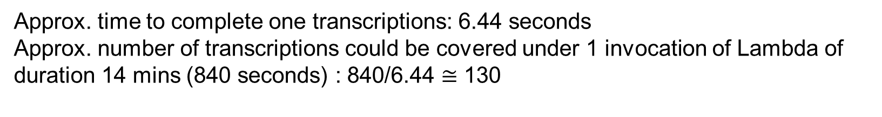
[DEBUG] 2023-07-17T05:19:40.192Z 7577087d-a08b-4a00-8058-a5bb04639298 message='Request to OpenAI API' method=post path=https://api.openai.com/v1/chat/completions
[DEBUG] 2023-07-17T05:19:40.192Z 7577087d-a08b-4a00-8058-a5bb04639298 api_version=None data='{"model": "gpt-3.5-turbo", "messages": [{"role": "user", "content": "Provide the reason for the sentiment in short and brief:\'Permanent change of address for deceased mother\'\\n\\nReason for the sentiment:"}], "temperature": 0.2, "n": 1}' message='Post details'
[DEBUG] 2023-07-17T05:19:41.698Z 7577087d-a08b-4a00-8058-a5bb04639298 https://api.openai.com:443 "POST /v1/chat/completions HTTP/1.1" 200 None
[DEBUG] 2023-07-17T05:19:41.698Z 7577087d-a08b-4a00-8058-a5bb04639298 message='OpenAI API response' path=https://api.openai.com/v1/chat/completions processing_ms=1413 request_id=ecbccacbe71ad9c15169dc905c81f3cd response_code=200
[DEBUG] 2023-07-17T05:19:41.700Z 7577087d-a08b-4a00-8058-a5bb04639298 message='Request to OpenAI API' method=post path=https://api.openai.com/v1/chat/completions
[DEBUG] 2023-07-17T05:19:41.700Z 7577087d-a08b-4a00-8058-a5bb04639298 api_version=None data='{"model": "gpt-3.5-turbo", "messages": [{"role": "user", "content": "Provide the emotion of the text:\'Permanent change of address for deceased mother\'\\n\\nEmotion:"}], "temperature": 0.2, "n": 1}' message='Post details'
[DEBUG] 2023-07-17T05:19:42.445Z 7577087d-a08b-4a00-8058-a5bb04639298 https://api.openai.com:443 "POST /v1/chat/completions HTTP/1.1" 200 None
[DEBUG] 2023-07-17T05:19:42.445Z 7577087d-a08b-4a00-8058-a5bb04639298 message='OpenAI API response' path=https://api.openai.com/v1/chat/completions processing_ms=556 request_id=ae33eee0fb10697ecd2182835b149180 response_code=200
1506 ms
745 ms
Approx. time to complete one transcriptions: 6.44 seconds
Approx. number of transcriptions could be covered under 1 invocation of Lambda of duration 14 mins (840 seconds) : 840/6.44 $≅$ 130

Slide 15
Estimated Cost (File contains only 1 column)- Old estimation
ChatGPT cost
ChatGPT bills on prompt tokens (number of characters used in prompt) and completion tokens (number of characters used for output)
Total Tokens for 11’Jul : 83664 (prompt_tokens + completion_tokens)
Total price for 11’Jul : 0.13 USD
Total price for 1 token ≈ .13/83664 ≈ .0000015538 USD
Approx. prompt tokens for 2500 transcriptions : 111724
Approx. completion tokens for 1 transcription : 106
Approx completion tokens for 2500 transcriptions: 106*2500 = 265000
Approx. tokens for 2500 transcriptions : 111724+265000 = 376724 (prompt + completion tokens)
Approx. price for 2500 transcriptions ≈ .0000015538* 376724 ≈ 0.59 USD
USPS are receiving approx. 20K transcriptions on daily basis
So, cost of ChatGPT ≈ (.59/2500)*20,000 ≈ 4.72 USD (daily) & 141.6 (monthly)

Slide 16
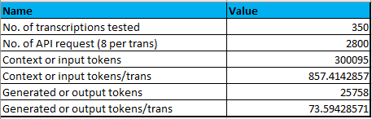
Estimated Cost (File contains only 1 column) – Updated estimation
ChatGPT cost (as per testing on 12th Dec’23)
ChatGPT bills on prompt tokens (word length of prompt) and completion tokens (word length of output) which purely depends on the length of the transcriptions.
https://openai.com/pricing states that: “Multiple models, each with different capabilities and price points. Prices are per 1,000 tokens. You can think of tokens as pieces of words, where 1,000 tokens is about 750 words. This paragraph is 35 tokens.”
ChatGPT-3.5 Turbo Price: Input - $.001/1K tokens Output - $.002/1K tokens
Est. Input cost for 350 transcriptions : 300095 x .001/1000 = .300095
Est. Output cost for 350 transcriptions : 25758 x .002/1000 = .051516
Total est. cost for 350 transcriptions : .300095+.051516 = $.351611
USPS are receiving approx. 20K transcriptions on daily basis Total est. cost for 20k transcriptions : .351611/350 x 20000 ≈ $ 20.10 (daily) & $ 602.77 (monthly)

Slide 17
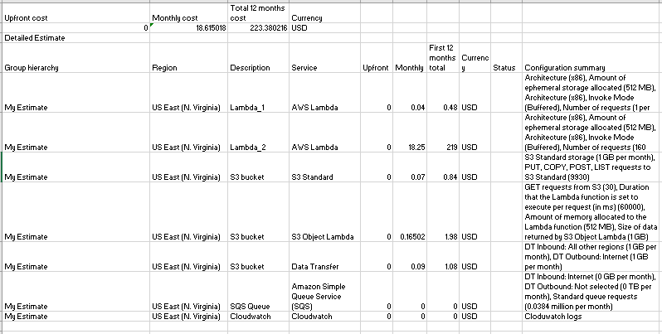
AWS cost (updated)
File size (8 parameters & 350 transcriptions) ≈ 236 KB
File size (8 parameters & 20K transcriptions) ≈ (236/350)*20000 ≈ 13486 KB
Size of file with only 2500 transcriptions ≈ 26 KB
Size of file with only 20K transcriptions ≈ (26/2500)*20000 ≈ 208 KB
Input-backup bucket & output bucket will store daily
≈ 208+13486 ≈ 13694 KB ≈ .013 GB
No. of request (PUT, POST, LIST,GET) in s3:
URL to s3 bucket – 1
Lambda1 fetch data from s3 bucket & conf.ini file – 2
Lambda1 will put file in backup – 1
Lamdba2 will put each processed chunk in s3 bucket and listing – 160+160 = 320
Lambda2 fetch data from conf.ini – 1
Lambda2 put consolidated file in output – 1
Miscellaneous request – 5
Total requests - 331 (daily) & 9930 (monthly)
Total cost ( AWS + CHATGPT)
≈ 18.62 (AWS)+602.77 (ChatGPT) ≈ 621.39 USD (monthly) and 7456.68 USD (yearly)

Slide 18
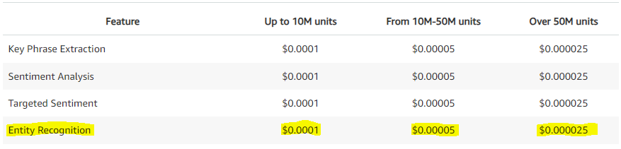
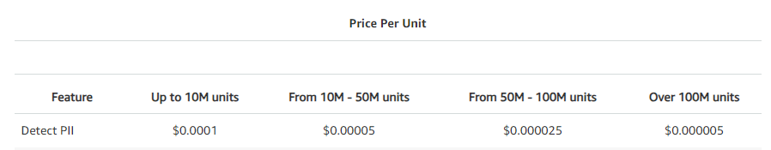
Scrubbing cost (estimation): USPS team gave information that survey comments csv file of 3375 transcriptions having 1324684 characters. We are using two features of comprehend to perform scrubbing (Entity recognition and Detect PII) Comprehend charges per month(1 units = 100 Characters): No. of characters for 3375 trans = 1324684 No. of characters for 20k trans = 7849979 (daily) No. of characters monthly = 235499377 No. of units (monthly) = 2354993.77 Monthly cost for Entity recognition (up to 10M units) : 2354993.77 * .0001 = $ 235.50 Monthly cost for PII detection (up to 10M units) : 2354993.77 * .0001 = $ 235.50 Total cost : 235.50+235.50 = $ 471 Total est. monthly cost ( ChatGPT + AWS + Comprehend) 621.39 + 471 = $ 1092.39 Total est. yearly cost ( ChatGPT + AWS + Comprehend) 7456.68 + 5652 = $ 13108.68

Slide 19
Account Details for ChatGPT
Steps to create paid account:
Go to the https://openai.com/ website and click on the “Sign Up” button in the top right corner of the page.
Fill out the form with your email address, password, and any other required information. Be sure to use a strong, secure password to protect your account.
Click the “Create Account” button to complete the process.
You’ll receive a confirmation email with a link to verify your account. Click on the link to complete the verification process and log in to your account.
Click the “Manage account”.
Go to Billing -> Overview -> Set up paid account. Provide the Card information, Name on card and Billing address.
Click Set up payment method.
Account type is Pay as you go. A temporary authorization hold will be placed on the card for $5. At the end of each calendar month, we'll be charged for all usage that happened during the month.

Slide 20
Rate Limit for ChatGPT
Rate limits are being enforced at the organization level.
Rate limits are measured in three ways: RPM (requests per minute), RPD (requests per day), and TPM (tokens per minute). Below are the default rate limits for our API.
PAID USERS (FIRST 48 HOURS) :
GPT-3.5-Turbo-16K | 2,000 RPD | 20 RPM | 120,000 TPM
PAID USERS (AFTER 48 HOURS) :
GPT-3.5-Turbo-16K | --- | 2,000 RPM | 180,000 TPM

